Slide 1
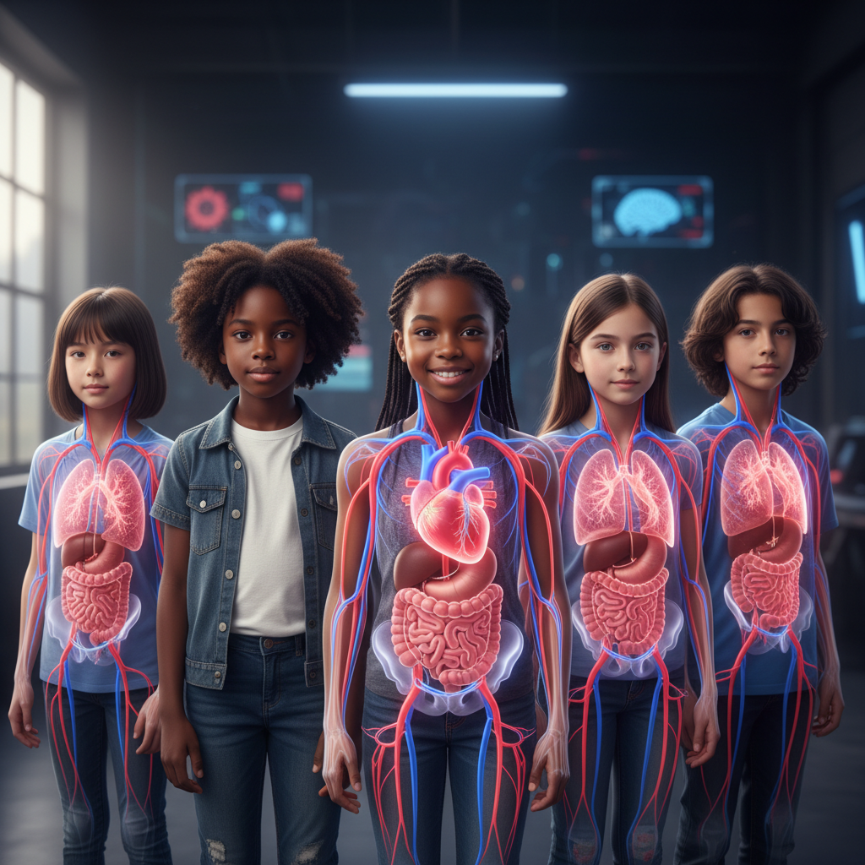
ModelIt!
Student Lesson
Your Body Is a City of Trillions
How Your Organ Systems Work Together to Keep You Alive
NGSS: MS-LS1-3
6th Grade
1/9

Slide 2
What You Will Learn Today
Learning Goals
* Explain how organ systems are made of organs, which are made of tissues, which are made of cells
* Model how heart rate, blood oxygen, nutrient intake, and physical activity interact in the body system
* Describe how the circulatory, respiratory, digestive, and muscular systems depend on each other
* Use evidence to argue that the body is a system of interacting subsystems
Key Vocabulary
Organ System
A group of organs that work together to perform a major body function
Homeostasis
The body's ability to maintain stable internal conditions even when the outside environment changes
Circulatory System
The heart, blood vessels, and blood that transport oxygen, nutrients, and waste throughout the body
Cellular Respiration
The process cells use to convert glucose and oxygen into energy (ATP), carbon dioxide, and water
2/9

Slide 3

The Big Question
How does your body run a city more complex than any humans have ever built — 24/7, without you even thinking about it?
How Your Organ Systems Work Together to Keep You Alive. Today we'll build a MODEL to discover the answer!
3/9

Slide 4

Today We Will Build a Model!
A model helps us understand complex systems!
1. LOCATE
Identify the COMPONENTS (parts) of the system
2. ESTABLISH
Connect them with RELATIONSHIPS (+ or -)
3. VISUALIZE
Build your model in ModelIt!
4. EVALUATE
Run SIMULATIONS to test scenarios
5. REVISE
Improve your model based on evidence
4/9

Slide 5

Activity 1: Sort the Components
Sort these components into EXTERNAL (inputs from outside) and INTERNAL (inside the system):
Your Components:
* Heart Rate
* Blood Oxygen Level
* Nutrient Intake
* Physical Activity
Think: Which components can we control? Which happen on their own?
5/9

Slide 6
Activity 2: Connect with Arrows
Draw arrows to show HOW components affect each other:
(+) POSITIVE Relationship
When one goes UP, the other goes UP too
(-) NEGATIVE Relationship
When one goes UP, the other goes DOWN
Think About It:
When physical activity increases, what has to happen to heart rate and blood oxygen? Can your body keep exercising if nutrient intake is zero?
6/9

Slide 7
Activity 3: Run the Simulation!
Test these scenarios in ModelIt!
Resting State
Set Physical Activity to low and observe how all systems maintain homeostasis
Sprint Mode
Lock Physical Activity to maximum and observe how the body responds
Skipping Lunch
Set Nutrient Intake to 10% during moderate activity — what fails first?
Watch the activity graphs change!
[ModelIt Platform Screenshot - Simulation Results Graph]
7/9

Slide 8
What Did We Discover?
Our Model Showed Us:
* Heart rate increases during exercise to deliver more oxygen and nutrients to working muscles
* Blood oxygen drops during intense activity because muscles consume oxygen faster than lungs can replace it
* Without adequate nutrients, the body can't produce enough energy for sustained physical activity
* All organ systems are interconnected — when one system is stressed, others must compensate
Answer: Your body works like a city because every organ system has a specialized job, and they ALL depend on each other. Your digestive system provides fuel, your respiratory system provides oxygen, your circulatory system delivers both to every cell, and your muscular system creates movement. Remove any one system and the whole city shuts down — just like a real city without power, water, or roads!
8/9

Slide 9

STEM Challenge: Design an Athletic Performance Plan
YOUR ENGINEERING MISSION
Design an evidence-based training and nutrition plan for a student athlete that optimizes how their body systems work together during competition.
The Challenge:
A middle school track team needs help. Their coach wants your biomedical team to design a plan that helps runners perform their best in the 400-meter race. Use your body systems model to explain your recommendations.
Think Like an Engineer:
* Based on your model, what happens to body systems during a 60-second sprint?
* What nutrients should the athlete eat before a race, and when should they eat them?
* How should training prepare the body's systems to handle the stress of competition?
REAL CAREER CONNECTION: Exercise Physiologists and Sports Medicine Specialists study how the body responds to physical activity and design training programs for athletes and patients. They earn $55,000–$100,000/year. The skills you're using TODAY are the same ones they use on the job!
9/9

